Slide 1
VIDEO CLASSIFICATION BASED ON ACTIVITY
Guided by
Mr.B.H. Dasaradha Ram
Submitted By
M. VENKAT SAI(16KN1A05E7)
SK. CHANDINI(16KN1A05G1)
P. KAVYA SRI(16KN1A05F7)

Slide 2
CONTENTS
Introduction
Project Objectives
Problem Definition
Solution for Problem Defintion
Process Diagram
Literature Review
Feasibility Study
System Requirements Specification
Publication

Slide 3
INTRODUCTION
Action recognition in video sequences is challenging problem in computer vision.
In the context of videos, an action is represented as a sequence of frames, which computers can easily understand actions by analyzing the contents of multiple frames in sequence.
We recognize human actions in away similar to our observations of actions in real life .
We use LSTM to consider the Sequence of information on frames of video in automatic understanding of actions in Action.

Slide 4
Project objectives
System accepts short videos representing Actions according to their Domain.
System Generates Images from the videos, Which will be used to train a Feature extractor or Scene Detector.
Bi-LSTM should be trained and is used to detect actions over video.
After Learning process, system accepts a video as input and predicts what kind of activity should be.

Slide 5
Problem Definition
Action recognition using video analysis is computationally expensive.
Each frame plays an important role in a video story, keeping information of sequential frames for a long time, makes the system more efficient.
Researchers have presented many solutions for this problem such as motion, space-time features, and trajectories.

Slide 6
Solution for Problem Definition
The solution to this problem is Combination of CNN and Bidirectional LSTM. Training CNN and Bi-LSTM Separately will greatly reduces difficulty.
The proposed method analyzes the complex pattern in the visual data of each frame, which cannot be efficiently identified using simple LSTM and multi-layer LSTM

Slide 7
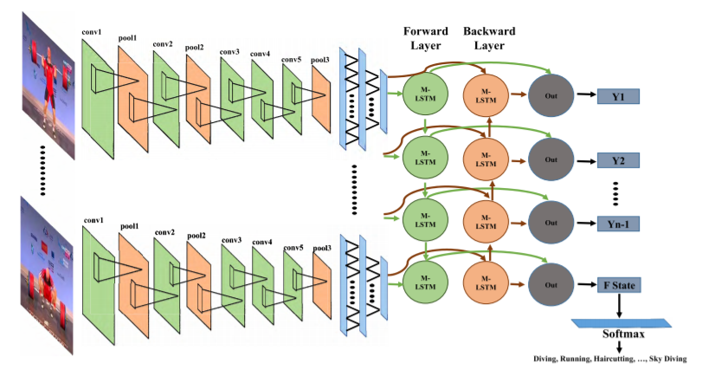
Process Diagram

Slide 8
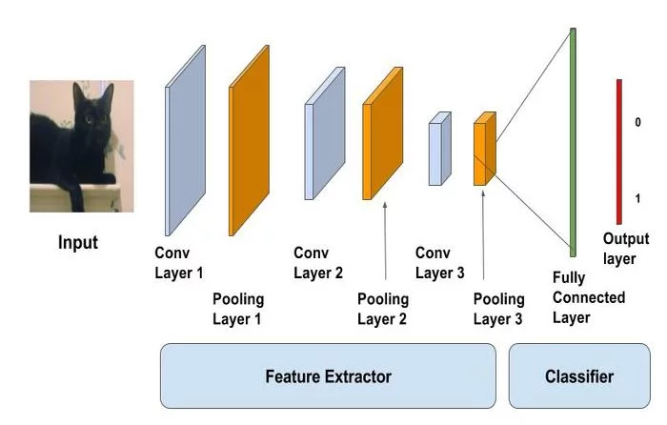
Here we select a Off-the-Shelf Feature Extractor.
Classifier can be Multi-layer perceptron,KNN etc,.
As a technique of Transfer Learning.

Slide 9
Steps in Generating Model
Dataset UCF
Generate and Save Images from Video DataSet
Extract Features From Videos
Classify Video
Training Scene Detector
Train BI-LSTM

Slide 10
Literature Review
Base Paper:
Action Recognition in Video Sequences using Deep Bidirectional LSTM With CNN Features
AMIN ULLAH 1, (Student Member, IEEE), JAMIL AHMAD 1, (Student Member, IEEE),KHAN MUHAMMAD 1, (Student Member, IEEE), MUHAMMAD SAJJAD 2,SUNG WOOK BAIK1, (Member, IEEE)
The main idea of LSTM architecture is its memory cell, input gate, output gate, and forget gate, which can maintain its state over time T.
Transfer Learning
It is encouraging to see the success of transfer learning on images extended to videos. The nearly 25% increase in accuracy on UCF after training on the YouTube-1M dataset is shockingly high!

Slide 11
System Analysis
Existing System:
Researchers have presented many solutions for this problem such as motion, space-time features, and trajectories . In existing system it uses traditional machine learning model to train the data because of using this technique machine requires a lot of data. In traditional model while training the data system requires to tune the channels to get high frequency.
Disadvantages :
By using this model machine uses more computing power.
It cannot perform accurate result.
It takes more time to get the result and complexity of data.

Slide 12
Proposed System:
A novel action recognition method by processing the video data using Convolutional Neural Network(CNN) and Bidirectional LSTM (Bi-LSTM) network.
Complexity of Training process is reduced by using Transfer Learning.
For each frame we extract the features of image using CNN then the features are pushed into a dequeue, which then passed to a LSTM which covers the action recognition part.
Advantages:
This system helps to speed up the model training process and get an accurate result.
Less computing power compared to Existing system
More efficient.

Slide 13
Overview
CNN
Bi-LSTM
An Image Classification Neural Network Architecture.
A State-of-Art CNN Architecture will be used.
To train this ANN we use a Technique called Transfer Learning.
This reduces the complexity of Training process
Bi-LSTM is well Used for Processing Sequential Data.
The Extracted Features for Sequence of Frames in a video is considered as input.

Slide 14
Modules
Video Frame Generator
CNN Trainer
Feature Extractor
Bi-LSTM Trainer
Video Classifier

Slide 15
Feasibility study
Economical Feasibility
In our project we are going to use all Open Source technologies so we can say that it is economically feasible.
Technical Feasibility
The CNN acts as a feature extractor and the output dense layer consists of the features extracted from the image and the extracted features are fed into the BI_LSTM to classify the video.
Training uses Transfer Learning Technique.

Slide 16
System Requirement Specification
Functional Requirements:
Create images from video- In this project we extract image from each-video for classifying it in each class and store them as a trained data.
CNN Trainer- Here we use Transfer learning concept and it works as a-model for extracting features will be trained here. The extracted images are taken as input.
Feature Extractor- after the cnn trainer it extract features using this-trained cnn model from video and save the extracted features
Bi LSTM Trainer- train based on extracted features as input and save-the trained model.
Video Classifier - using a cnn to extract features i.e predict image scene-action, use a trained lstm for predicting the video class for the given video.

Slide 17
Non Functional Requirements
Non Functional Requirements:
Efficiency: The back-end Tensorflow was developed in a c++ language which-consider to be an efficient is used in our project.
Usability: The system is designed with completely automated process hence-there is no or less user intervention.
Performance: This system is developing in the high level languages and using-the advanced back end technologies it will give response to the end user and client system with in very less time

Slide 18
System Requirements
Software Requirements:
OS : Linux or Windows
Environment : Python-3.x
Library : Tensorflow,High level module : Keras
Datasets : UCF
Google co-lab for Training (Google Cloud)
Hardware Requirements:
Ram : 4GB+
Hard Disk: 80GB+
Processor : i3 or i5
GPU : Nvidia GTX 1080

Slide 19
Publication
We have published a paper of Title: “ACTIVITY DETECTION IN UNCONSTRAINED VIDEOS USING CONVOLUTION NEURAL NETWORK AND BI-LSTM” under the guidance of Mr. B. H. DASARADHA RAM (Associate professor) in the journal “International Journal For Recent Developments in Science & Technology” of ISSN Number is 2585-4575, with Volume 04, Issue-06.

Slide 20
Thank You

